Slide 1
FILE SHARING ON CROSS PLATFORM USING GUI
Project Members: Vidya Honde
Shreya Patil
Pratiksha Girmaji
Shraddha Gardas

Slide 2
Introduction
Open source technology used to share files within network on cross platform.
It also share the hardware : printer.
File sharing is efficient and secure.
Using GUI , it is easy to share files on cross platform.
Developing GUI Tkinter tool is used.
Open source tool for developing GUI.

Slide 3
Objective
Previous file sharing is on command based.
To ease the file and hardware sharing using GUI instead of command based.
Automate the file sharing in network and make it user interface.
To make familiar for windows user’s.

Slide 4
Abstract
We are developing samba using GUI for make it users friendly within network.
It provides file sharing along with security.
Provides user authentication,credentials.
Easy to handle for windows user’s also.
Automate file sharing in network.

Slide 5
Existing System
Current system based on command which on linux.
We need to install packages on client side for file sharing.
We need to configure samba on server side also such as share name, users, share directory.
It is not easy to handle its configuartion.

Slide 6
Proposed System
To make user friendly with samba.
Do not need install any packages on server and client side.
Automate the package installation.
Any user or server admin can handle this GUI samba.
Provides security and authentication using with GUI.

Slide 7
Project Diagrams
Usecase
Data Flow Diagram
Level 0
Level 1
Level 2
Class Diagrams
Sequence Diagram

Slide 8
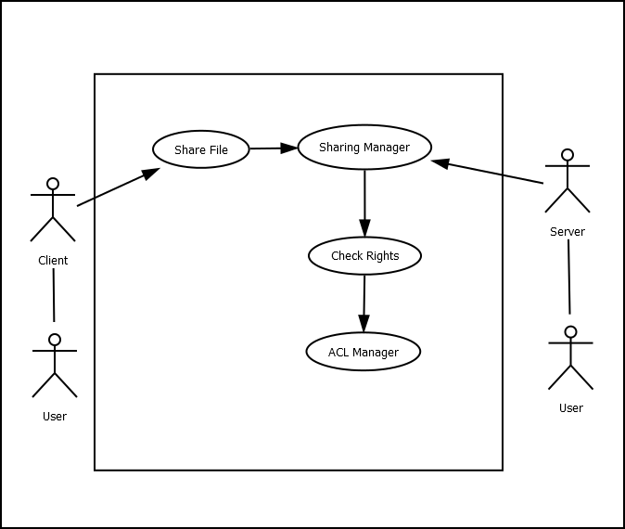
Usecase diagram

Slide 9
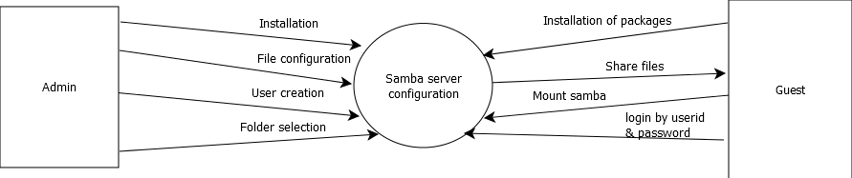
Data Flow Diagram-level0

Slide 10
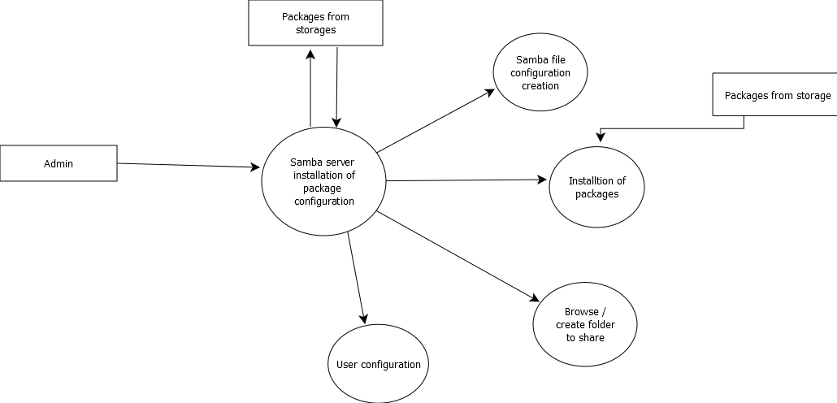
Data Flow Diagram-level(1)

Slide 11
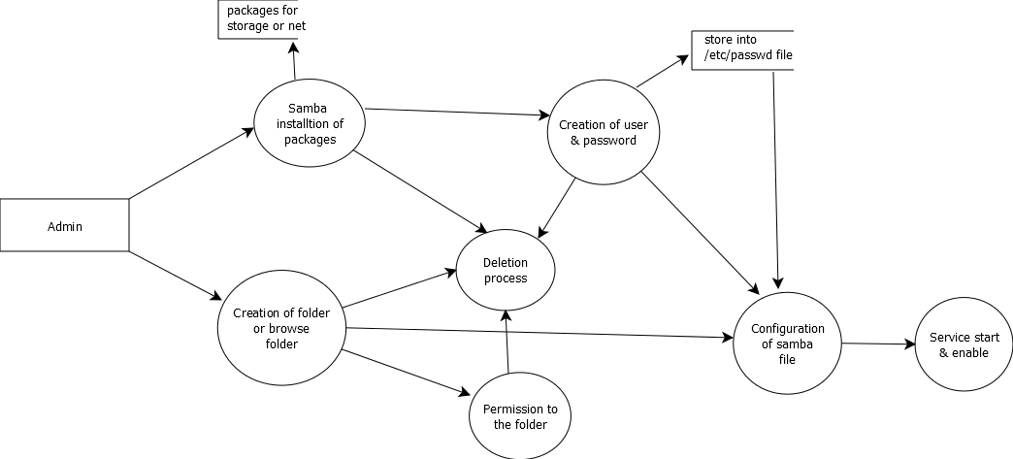
Data Flow Diagram-level(2)

Slide 12
Class Diagram

Slide 13
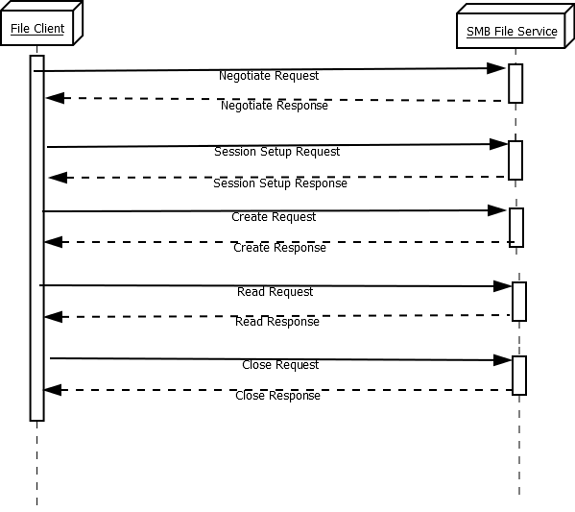
Sequence diagram

Slide 14
Future Scope
Creating databases for exchanging information.
For new users have facility to handle file sharing.
Automating the samba so users does not need to worry about its packages.
Easy to share the file.

